Slide 1

Chapter 1
Introduction
Copyright © 2007
Prentice-Hall, Inc.

Slide 2
Chapter 1: Introduction
LEARNING OBJECTIVES:
Upon completing this chapter, you should be able to do the following:
Explain what multivariate analysis is and when its application is appropriate.
Define and discuss the specific techniques included in multivariate analysis.
Determine which multivariate technique is appropriate for a specific research problem.
Discuss the nature of measurement scales and their relationship to multivariate techniques.
Describe the conceptual and statistical issues inherent in multivariate analyses.

Slide 3
What is Multivariate Analysis?
What is it? Multivariate Data Analysis = all statistical methods that simultaneously analyze multiple measurements on each individual or object under investigation.
Why use it?
    Measurement
    Explanation & Prediction
    Hypothesis Testing

Slide 4
Basic Concepts of Multivariate Analysis
The Variate
Measurement Scales
    Nonmetric
    Metric
Multivariate Measurement
Measurement Error
Types of Techniques

Slide 5
The Variate
The variate is a linear combination of variables with empirically determined weights.
Weights are determined to best achieve the objective of the specific multivariate technique.
Variate equation: (Y’) = _{W1} X₁ + _{W2} X₂ + . . . + _{Wn} X_{n}
Each respondent has a variate value (Y’).
The Y’ value is a linear combination of the entire set of variables. It is the dependent variable.
Potential Independent Variables:
    X1 = income
    X2 = education
    X3 = family size
    X4 = ??

Slide 6
Types of Data and Measurement Scales
Data
Nonmetric
or
Qualitative
Metric
or
Quantitative
Nominal
Scale
Ordinal
Scale
Interval
Scale
Ratio
Scale

Slide 7
Measurement Scales
Nonmetric
  Nominal – size of number is not related to the amount of the characteristic being measured
  Ordinal – larger numbers indicate more (or less) of the characteristic measured, but not how much more (or less).
Metric
  Interval – contains ordinal properties, and in addition, there are equal differences between scale points.
  Ratio – contains interval scale properties, and in addition, there is a natural zero point.
NOTE: The level of measurement is critical in determining the appropriate multivariate technique to use!

Slide 8
Measurement Error
All variables have some error. What are the sources of error?
Measurement error = distorts observed relationships and makes multivariate techniques less powerful.
Researchers use summated scales, for which several variables are summed or averaged together to form a composite representation of a concept.

Slide 9
Measurement Error
In addressing measurement error, researchers evaluate two important characteristics of measurement:
Validity = the degree to which a measure accurately represents what it is supposed to.
Reliability = the degree to which the observed variable measures the “true” value and is thus error free.

Slide 10
Statistical Significance and Power
Type I error, or α, is the probability of rejecting the null hypothesis when it is true.
Type II error, or β, is the probability of failing to reject the null hypothesis when it is false.
Power, or 1-β, is the probability of rejecting the null hypothesis when it is false.
 | H₀ true | H₀ false
Fail to Reject H₀ | 1-α | β Type II error
Reject H₀ | α Type I error | 1-β Power

Slide 11
Power is Determined by Three Factors:
Effect size: the actual magnitude of the effect of interest (e.g., the difference between means or the correlation between variables).
Alpha (α): as α is set at smaller levels, power decreases. Typically, α = .05.
Sample size: as sample size increases, power increases. With very large sample sizes, even very small effects can be statistically significant, raising the issue of practical significance vs. statistical significance.

Slide 12
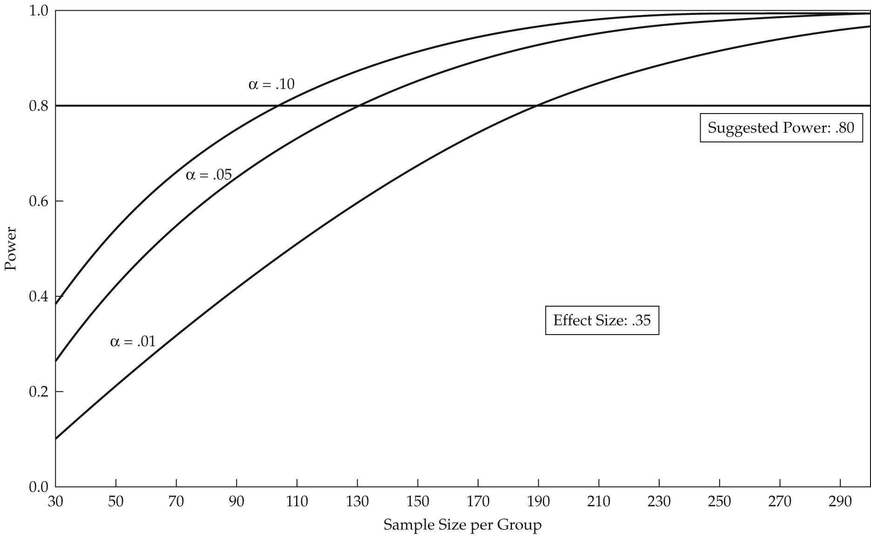
Figure 1-1 Impact of Sample Size on Power

Slide 13
Rules of Thumb 1–1
Statistical Power Analysis Researchers should always design the study to achieve a power level of .80 at the desired significance level. More stringent significance levels (e.g., .01 instead of .05) require larger samples to achieve the desired power level. Conversely, power can be increased by choosing a less stringent alpha level (e.g., .10 instead of .05). Smaller effect sizes always require larger sample sizes to achieve the desired power. Any increase in power is most likely achieved by increased sample size.

Slide 14
Types of Multivariate Techniques
Dependence techniques: a variable or set of variables is identified as the dependent variable to be predicted or explained by other variables known as independent variables.
    Multiple Regression
    Multiple Discriminant Analysis
    Logit/Logistic Regression
    Multivariate Analysis of Variance (MANOVA) and Covariance
    Conjoint Analysis
    Canonical Correlation
    Structural Equations Modeling (SEM)

Slide 15
Types of Multivariate Techniques
Interdependence techniques: involve the simultaneous analysis of all variables in the set, without distinction between dependent variables and independent variables.
  Principal Components and Common Factor Analysis
  Cluster Analysis
  Multidimensional Scaling (perceptual mapping)
  Correspondence Analysis

Slide 16
Selecting a Multivariate Technique
What type of relationship is being examined – dependence or interdependence?
Dependence relationship: How many variables are being predicted?
  What is the measurement scale of the dependent variable?
  What is the measurement scale of the predictor variable?
Interdependence relationship: Are you examining relationships between variables, respondents, or objects?

Slide 17
Multiple Regression
A single metric dependent variable is predicted by several metric independent variables.

Slide 18
Discriminant Analysis
A non-metric (categorical)
dependent variable is predicted by
several metric independent variables.
Examples:
Gender – Male vs. Female
Heavy Users vs. Light Users
Purchasers vs. Non-purchasers
Good Credit Risk vs. Poor Credit Risk
Member vs. Non-Member

Slide 19
Logistic Regression
A single nonmetric dependent variable is predicted by several metric independent variables. This technique is similar to discriminant analysis, but relies on calculations more like regression.

Slide 20
MANOVA
Several metric dependent variables
are predicted by a set of nonmetric (categorical) independent variables.

Slide 21
CANONICAL ANALYSIS
Several metric dependent variables are predicted by several metric independent variables.

Slide 22

CONJOINT ANALYSIS
. . . is used to understand respondents’ preferences for products and services.
In doing this, it determines the importance of both:
    attributes and
    levels of attributes
. . . based on a smaller subset of combinations of attributes and levels.

Slide 23
CONJOINT ANALYSIS
Typical Applications:
Soft Drinks
Candy Bars
Cereals
Beer
Apartment Buildings; Condos
Solvents; Cleaning Fluids

Slide 24
Structural Equations Modeling (SEM)
Estimates multiple, interrelated dependence relationships based on two components:
    Structural Model
    Measurement Model

Slide 25

Factor Analysis
. . . . analyzes the structure of the interrelationships among a large number of variables to determine a set of common underlying dimensions (factors).

Slide 26
Cluster Analysis
. . . . groups objects (respondents, products, firms, variables, etc.) so that each object is similar to the other objects in the cluster and different from objects in all the other clusters.

Slide 27
Multidimensional Scaling
. . . identifies “unrecognized” dimensions that affect purchase behavior based on customer judgments of:
    similarities or
    preferences
and transforms these into distances represented as perceptual maps.

Slide 28
Correspondence Analysis
. . . uses non-metric data and evaluates either linear or non-linear relationships in an effort to develop a perceptual map representing the association between objects (firms, products, etc.) and a set of descriptive characteristics of the objects.

Slide 29
Guidelines for Multivariate Analysis
Establish Practical Significance as Well as Statistical Significance.
Sample Size Affects All Results.
Know Your Data.
Strive for Model Parsimony.
Look at Your Errors.
Validate Your Results.

Slide 30
A Structured Approach to
Multivariate Model Building:
Stage 1: Define the Research Problem, Objectives, and
Multivariate Technique(s) to be Used
Stage 2: Develop the Analysis Plan
Stage 3: Evaluate the Assumptions Underlying the
Multivariate Technique(s)
Stage 4: Estimate the Multivariate Model and Assess
Overall Model Fit
Stage 5: Interpret the Variate(s)
Stage 6: Validate the Multivariate Model

Slide 31
Description of HBAT Primary Database Variables
Variable Description Variable Type
Data Warehouse Classification Variables
X1 Customer Type nonmetric
X2 Industry Type nonmetric
X3 Firm Size nonmetric
X4 Region nonmetric
X5 Distribution System nonmetric
Performance Perceptions Variables
X6 Product Quality metric
X7 E-Commerce Activities/Website metric
X8 Technical Support metric
X9 Complaint Resolution metric
X10 Advertising metric
X11 Product Line metric
X12 Salesforce Image metric
X13 Competitive Pricing metric
X14 Warranty & Claims metric
X15 New Products metric
X16 Ordering & Billing metric
X17 Price Flexibility metric
X18 Delivery Speed metric
Outcome/Relationship Measures
X19 Satisfaction metric
X20 Likelihood of Recommendation metric
X21 Likelihood of Future Purchase metric
X22 Current Purchase/Usage Level metric
X23 Consider Strategic Alliance/Partnership in Future nonmetric

Slide 32
Multivariate Analysis
Learning Checkpoint:
What is multivariate analysis?
Why use multivariate analysis?
Why is knowledge of measurement scales
important in using multivariate analysis?
What basic issues need to be examined
when using multivariate analysis?
Describe the process for applying
multivariate analysis.

